Slide 1



Targeting the interplay between myeloid cells and CD4+ T-Cells for HIV cure
Éric A. Cohen PhD, FRSC
Lead Investigator, Canadian HIV Cure Enterprise (CanCURE), Montreal Clinical Research Institute (IRCM), Université de Montréal, Montreal, Canada
@cancurehiv
Share your thoughts on this presentation with #IAS2019

Slide 2
Disclosure
Member, Scientific Advisory Board of Theratechnologies

Slide 3
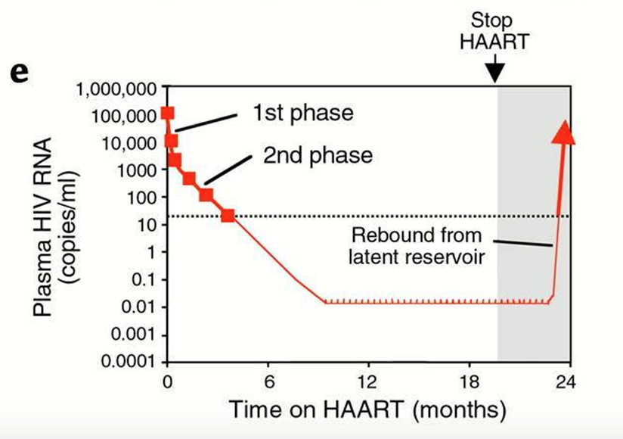
The persistent latent HIV reservoir
VR comprises replication-competent HIV provirus integrated into long-lived quiescent cells that persist in spite of ART
Many fundamental characteristics and properties of this reservoir remain unknown
Siliciano and Siliciano, 2000

Slide 4
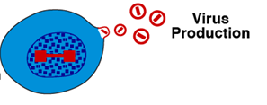
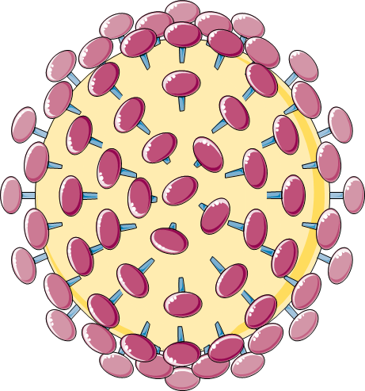
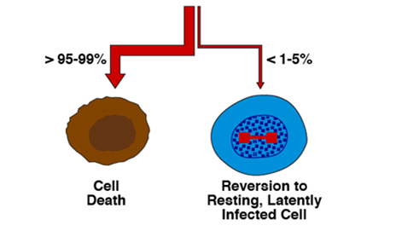


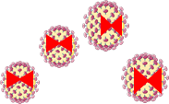

Cellular reservoirs
Lymphoid Cells
Myeloid Cells
Interplay
Dendritic cells (DC)
Monocytes
Macrophages
Permissive
to HIV infection
Memory CD4+T cells (central), Th17; Th17/Th1, Treg, Tfh represent the best characterized reservoir of HIV during ART

Slide 5
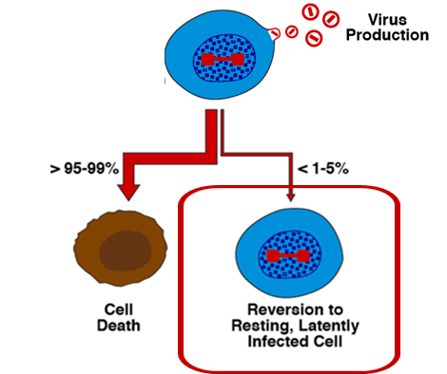


Cellular Reservoirs
Lymphoid Cells
Myeloid Cells
Interplay
Dendritic cells (DC)
Monocytes
Macrophages
Memory CD4+T cells (central), Th17; Th17/Th1, Treg, Tfh represent the best characterized reservoir of HIV during ART

Slide 6
Pathways to HIV cure
To eradicate the replication-competent reservoir – "classic cure"
  Estimated to require >3.5- 4.0 log reduction in VRs
Control viral rebound without eradication of HIV in the absence of ART – "Sustained virologic remission" or "Functional Cure"
Reservoir Reduction
Ongoing Viral Suppression
Enhanced immunity
(e.g. therapeutic vaccine)
Exogenous long lasting suppressive
Agents (e.g.: vector delivery of bNAbs)
Adapted from K.J. Bar, CROI 2019

Slide 7
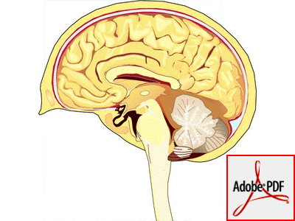

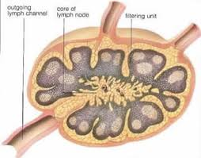
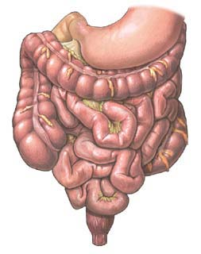
Anatomic Sites of HIV Persistence
Brain
To target HIV reservoirs, we must know exactly their anatomic distribution
Animal models do not always provide an accurate representation of what is occurring in humans
Gastrointestinal
cells
Lymph
nodes
Peripheral
blood
Bone
marrow
T-lymphocytes
macrophages
cellular reservoirs
anatomical reservoirs
Nature Reviews Immunology 14, 24-35, 2014

Slide 8
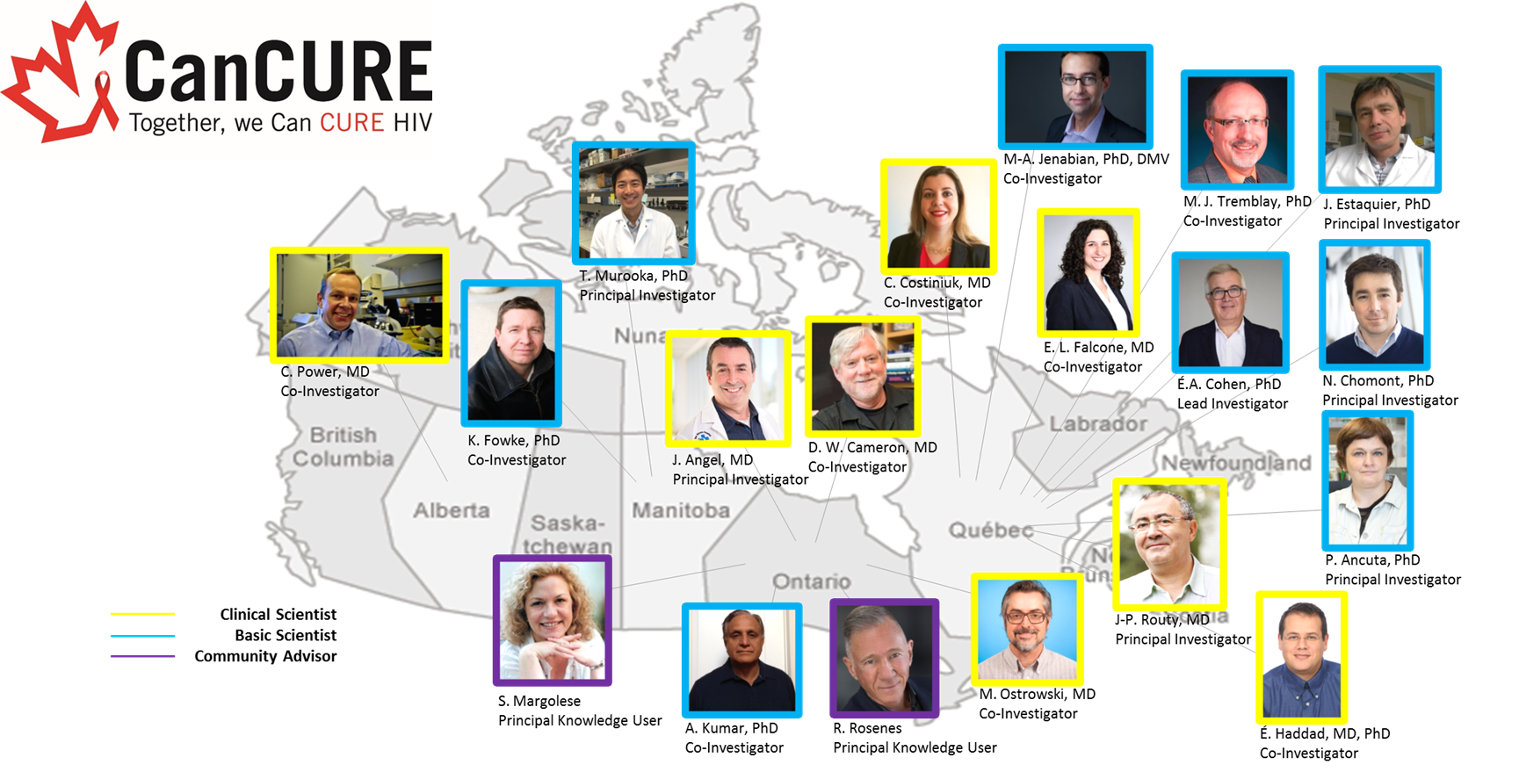
CanCURE Team

Slide 9
CanCURE Scientific Program
Focuses on investigating the direct and indirect contribution of myeloid cells to HIV persistence during ART and developing strategies to achieve stable remission of HIV
Notes:
.

Slide 10
End-of-life HIV research
Medical Assistance in Death (MAiD) has been legal in Canada since June 2016
Individuals living with HIV, who have also opted for MAiD, have had the opportunity to participate in post-mortem tissue donations
  Time of death is planned
  Clinical information is readily available
  Consent for tissue donation was collected during consenting process for MAiD
  Provides an opportunity for research participation
Sandstrom et al. Clin. Infect. Dis., 2019

Slide 11
Participant
Virally suppressed for over 11 years (lopinavir/ritonavir + tenofovir/emtracitabine)
No identifiable opportunistic infection/malignancy that would be expected to influence the viral reservoir
Possessed a strong desire to contribute to HIV research
T. Sandstrom and J. Angel
Notes:
.

Slide 12

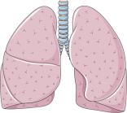



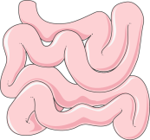
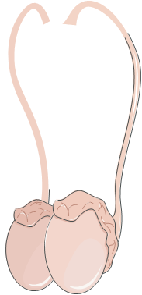
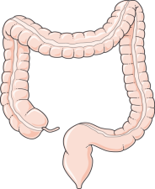
Methodology
16 anatomical sites were investigated:
Whole Organs
Lungs
Liver
Spleen
Testes
Brain
GI Tract:
Duodenum (6” length)
Jejunum (6” length)
Ileum (6” length)
Colon (6” length)
Rectum (2-3” length)
Lymph nodes
Mesenteric
Hilar
Mediastinal
Axillary
Inguinal
DNA and RNA from snap frozen tissues (6 pieces per organ) were extracted
Total HIV DNA was measured by qPCR.
Cell associated HIV RNA (LTR-Gag) was measured by RT-qPCR.
T. Sandstrom and J. Angel

Slide 13
HIV DNA in gut, lymph nodes and other organs
HIV DNA could be detected in the vast majority of tissues analyzed
Highest levels detected in LN, particularly in Axillary and Hillar LN
Lamers et al., J. Virol., 2016
M. J. Ruiz and N. Chomont

Slide 14
HIV RNA in gut, lymph nodes, and other organs
HIV LTR-Gag RNA could be detected
in LN and lungs
but was rare in
other organs
M. J. Ruiz and N. Chomont

Slide 15
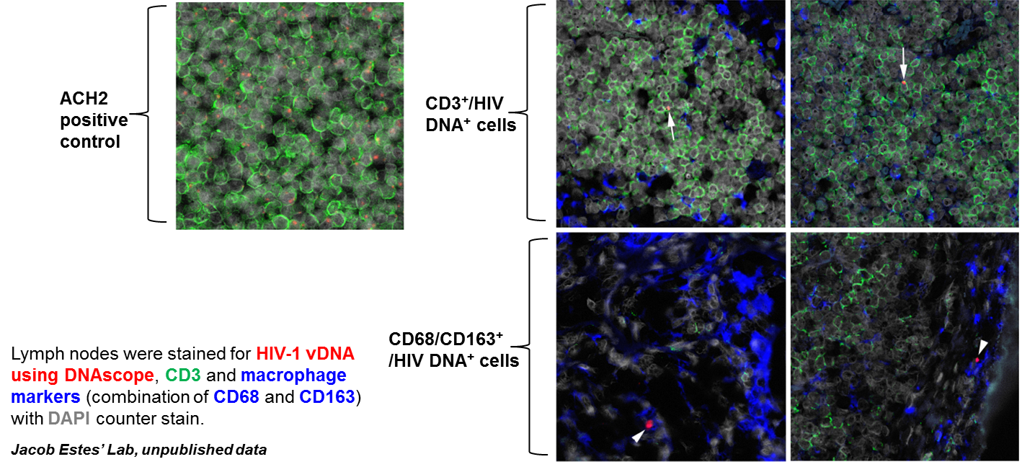
HIV DNA Scope in the lymph node
HIV DNA is detected in the vast majority of tissues in human while detection of RNA is rare and detected in selected tissues
Determine the replication-competency of HIV populations in these tissues
Phenotype cell populations from cryopreserved tissues

Slide 16
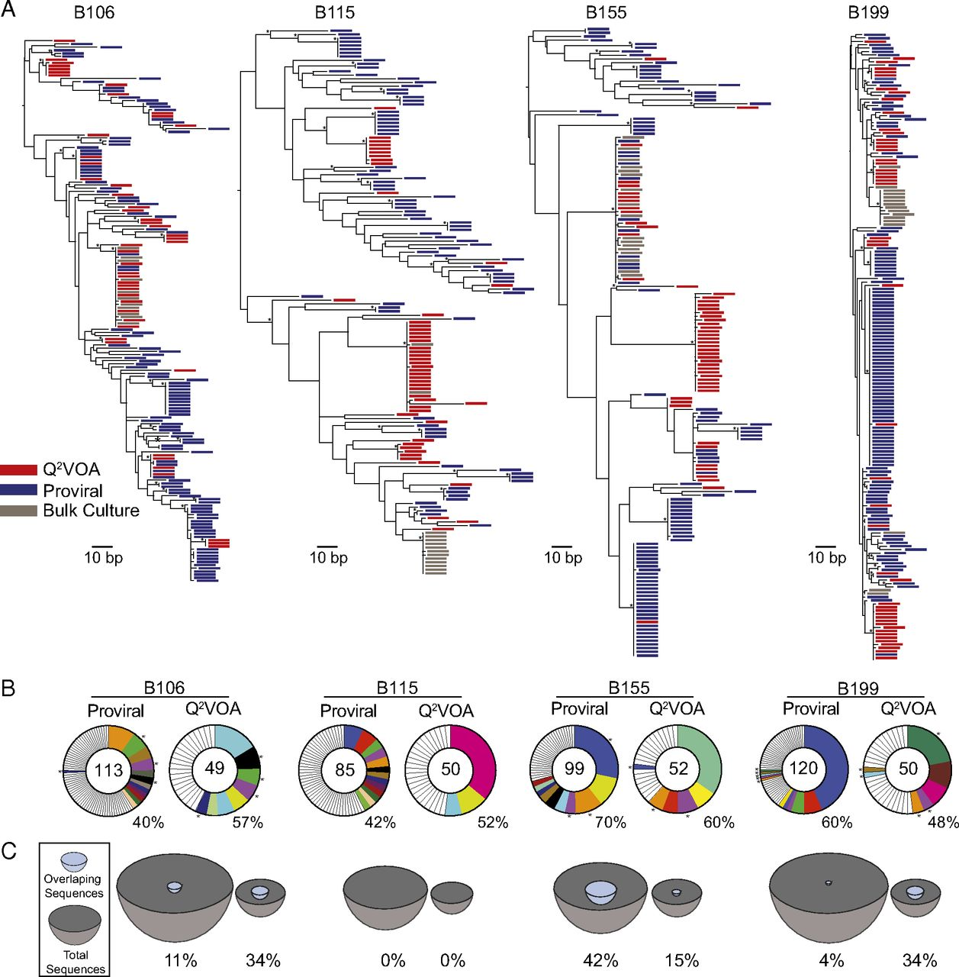
Expanded clones in the reservoir
Large fraction of replication-competent
reservoir is part of clonally-expanded
lineages
  Expanded clone make up 50-60%
  of the latent reservoir at any given time
Drivers of clonal expansion
  Homeostatic proliferation (IL-15, IL7)
  Antigen-driven proliferation: HIV, CMV, flu
  bacteria
  Both?
Wagner et al. Science, 2014; Maldarelli et al., Science., 2014; Cohen et al., Cell , 2015; Lorenzi et al., PNAS, 2015; Simonetti et al., 2016; Hosmane et al,, J.Exp. Med , 2017; Bui et al. PLoS Pathg., 2017; Salantes et al., JCI, 2018; Wang et al.. PNAS 2018

Slide 17
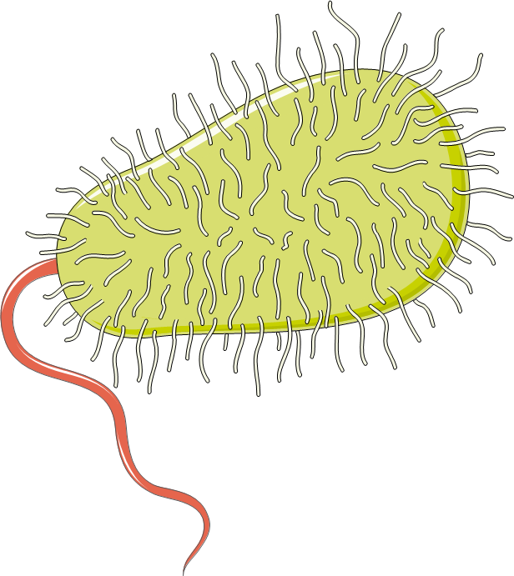
Understanding the mechanisms at play during interactions between antigen presenting cells of myeloid lineages, and CD4+ T cells that favor the establishment and maintenance of VR in CD4+ Tm cells is paramount to devise strategies to reduce HIV reservoirs
Antigenic Presentation
Clonal Expansion
!
!
!
!
Dendritic cells
!
!
!
CD4+ T-cells

Slide 18
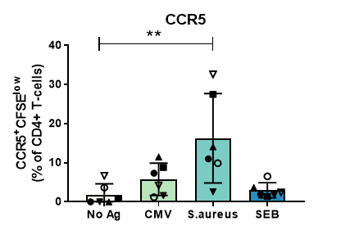
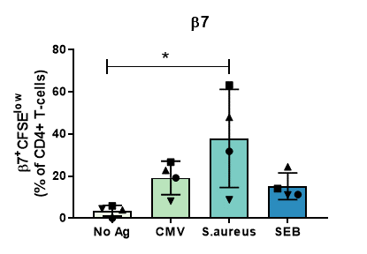
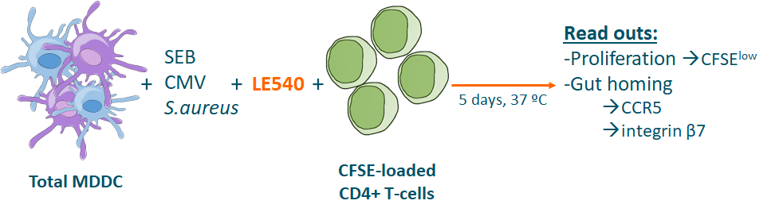
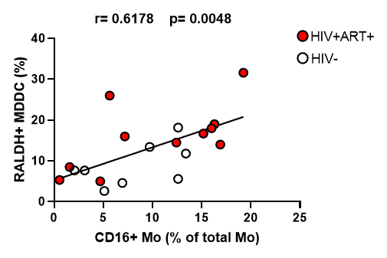
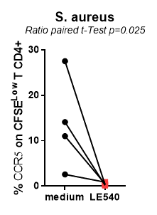
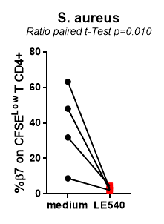

S. aureus promotes RALDH2 activity in MDDC and a CCR5+ITGβ7+ phenotype in co-cultured CD4+ T-cells
RALDH: retinoic acid synthesizing
enzyme
A. Cattin and P. Ancuta, In preparation

Slide 19
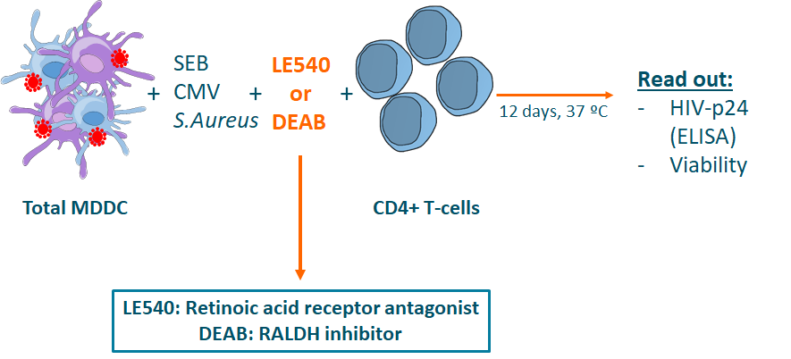
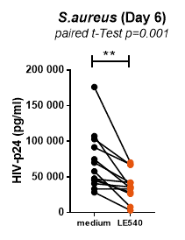
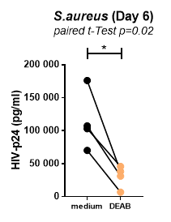
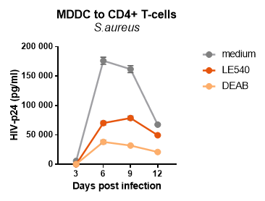
MDDC trans infect S. aureus-specific CD4+ T-cells via a RALDH2/retinoic acid-dependent mechanism
A. Cattin and P. Ancuta, In preparation

Slide 20
Proposed Model
Diet
S.aureus
RALDH activity is induced by S. aureus
in MDDCS of HIV- and HIV+ART+ individuals
RALDH2 activity in MDDC acts on
antigen-specific CD4+ T-cells via RA to:
- Up regulate CCR5 and integrin β7
expression
- Facilitate HIV trans infection
Blockade of the RALDH pathway inhibit
the trans infection potential of MDDC to
CD4+ T-cells
This process may promote
the establishment of latent reservoir
in the gut via facilitation of trans-infection
CCR5
TLR2
Gut Homing
Vit A
α4β7
RDH
RALDH2
RA
RAR/RXR
RAR/RXR
HIV
CD4 T cell
CD103
CD16+ MDDC
A. Cattin and P. Ancuta, In preparation

Slide 21
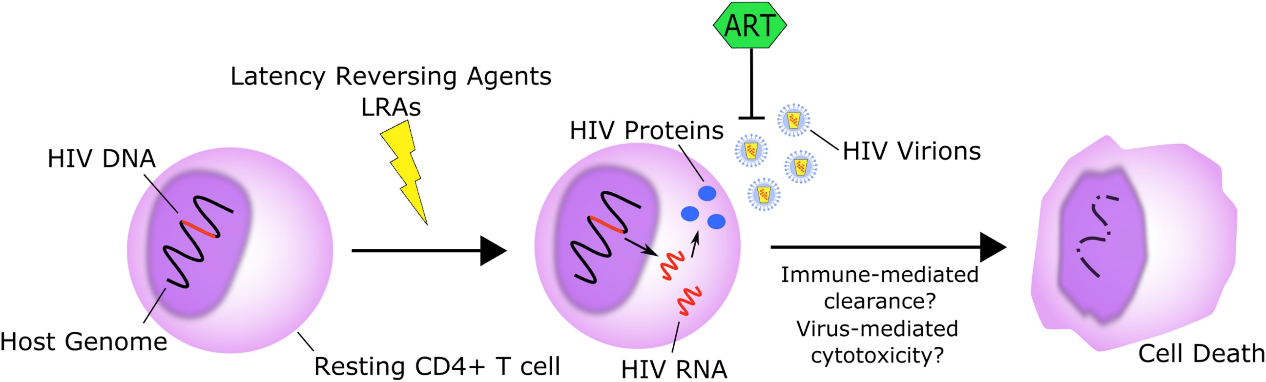
Shock and Kill approach
Viral Suppression
(ART)
Latency Reversal Agents
LRAs
I
Enhance clearance by native or engineered cells
Shock : LRAs to reveal latently- infected cells
Kill : Enhanced native or engineered immune cells to clear HIV-infected cells
Suppress/Protect : Vulnerable cells protected from infection
Kim et al. , Cell Host and Microbe, 2018

Slide 22
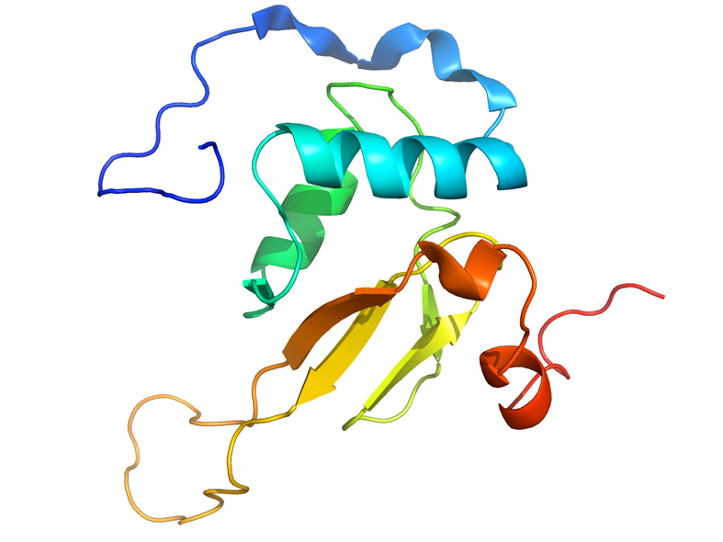
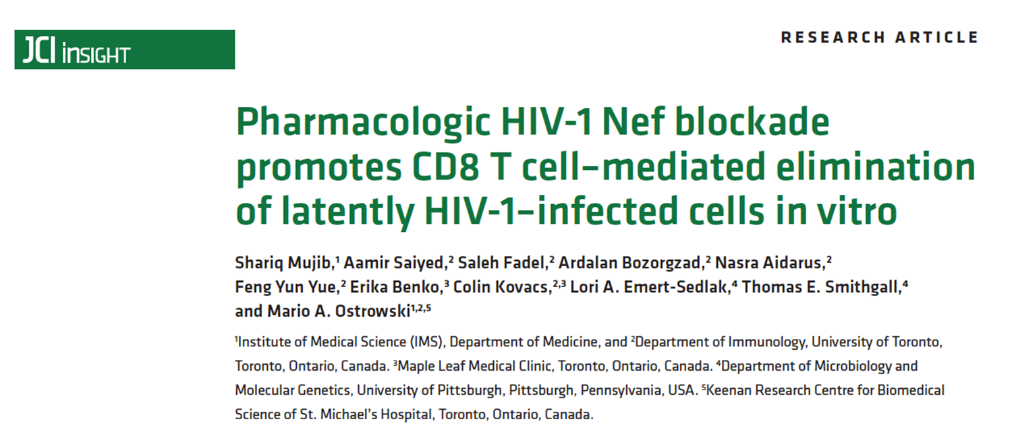
Enhancing the recognition and elimination of latently infected T cells by targeting HIV Nef

Slide 23

Nef downregulates MHC-I
Nef
Nef
M. Ostrowski

Slide 24
Nef protects HIV-infected cells
Nef
Killer T cell
HIV infected cell
HIV infected T cell survives
M. Ostrowski

Slide 25
Hypothesis: blocking Nef function
Nef
Inhibitor of Nef protein.
Thomas Smithgall
[University of Pittsburgh]
M. Ostrowski

Slide 26
Hypothesis: restore recognition and killing
Killer T cell
HIV infected cell
Quantify anti-viral product IFN-gamma:
Amounts mean more killing.
M. Ostrowski
Notes:
Would restore recognition and killing of reactivated latently infected cells

Slide 27
Nef blockade results in greater elimination of latently HIV-infected CD4+ T cells

Slide 28
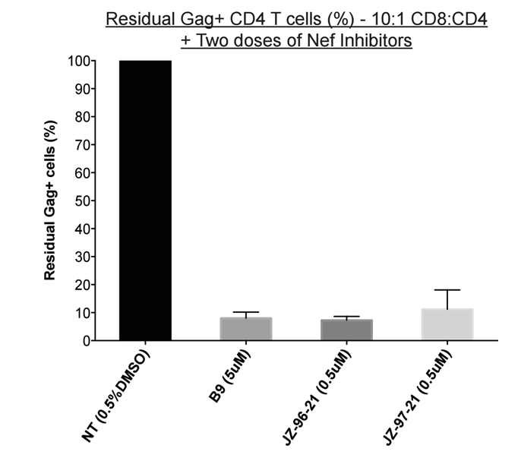
Dualdosing with Nef inhibitors eliminated the majority of latently HIV1-infected CD4+ T cells.
Nef blockade enhances killer (CD8) T cell recognition and elimination of latently HIV infected cells.
May be a viable strategy to facilitate reduction of the reservoir.
n=2; Mean ± SD shown

Slide 29





Acknowledgements
Collaborators
Petronela Ancuta
Jonathan Angel
Nicolas Chomont
Jérôme Estaquier
Thomas Murooka
Jean-Pierre Routy
Cecilia Costiniuk
Bill Cameron
Emilia Falcone
Keith Fowke
Élie Haddad
Ali Jenabian
Ashok Kumar
Mario Ostrowski
Christopher Power
Michel J. Tremblay
Jacob Estes
Tom Smithgall
Marie Julia Ruiz
Teslin Sandstrom
Shariq Mujib
Amélie Cattin
Delphine Planas
The Study Participants
Ron Rosenes
Shari Margolese
Anita Del Corpo

Slide 30
THANK YOU

